Slide 1
What Makes Fake Images Detectable? Understanding Properties that Generalize
Lucy Chai, David Bau, Ser-Nam Lim, and Phillip Isola
MIT CSAIL
presented by James Ecker
CS895 | 29 Oct 2020

Slide 2
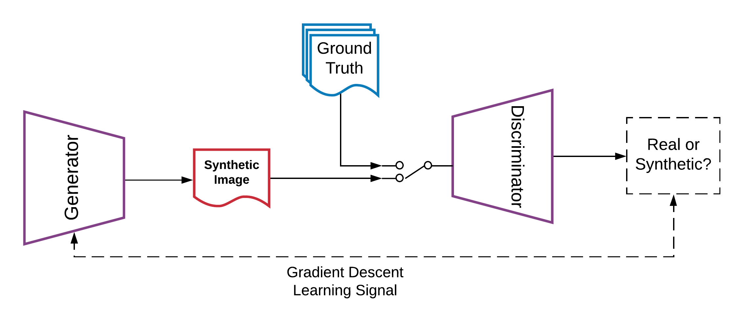
Generative Adversarial Networks
Generator
Generates synthetic data to try to fool the Discriminator
Input: Latent Random Variable (z)
Output: Synthetic Data
Learns to output data with high probability of belonging to ground truth dataset (the problem domain)
Discriminator
Classifies whether an instance of data is ”real” or not
Input: data of interest
Output: classification of real/not real
Minimax Game
The Generator and Discriminator engage in a two-player zero-sum game
The “game” ends when the discriminator can get no better than chance (50% accuracy)
Ecker “Deep Learning for Autonomous Systems at NASA Langley Research Center”

Slide 3
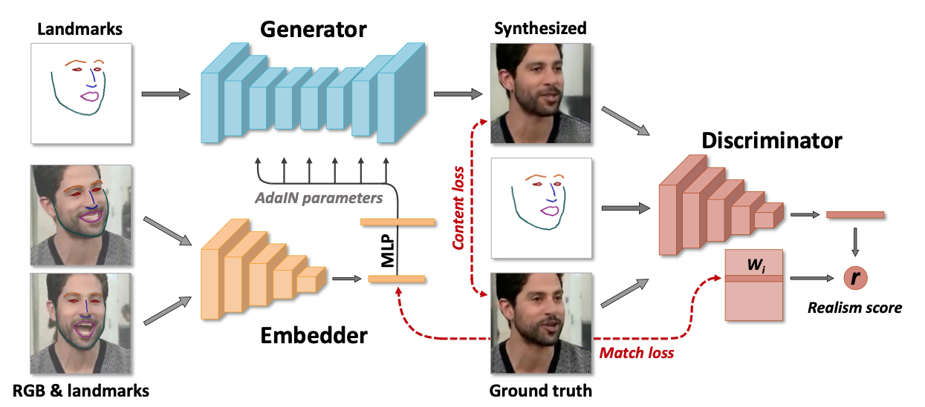
GAN-based Deepfakes – DeepFaceLab
Zakharov et al. “Few-Shot Adversarial Learning of Realistic Neural Talking Head Models” 10.1109/ICCV.2019.00955 – fig. 2

Slide 4
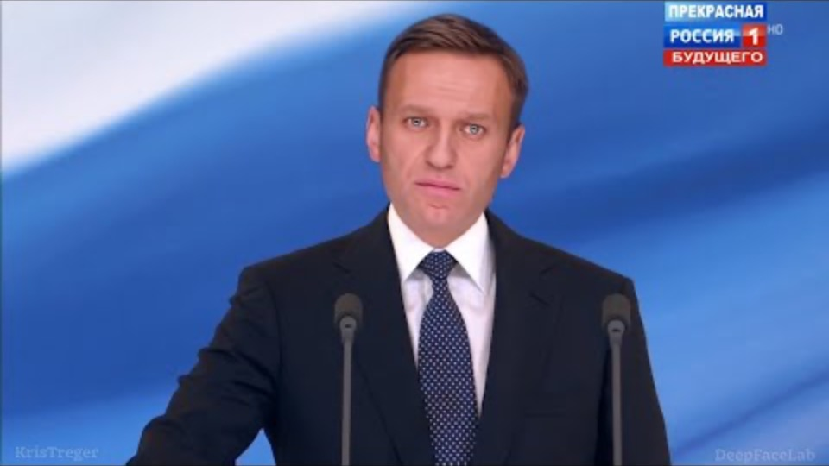
DeepFaceLab Creates Realistic Face Swaps
https://www.youtube.com/watch?v=xr5FHd0AdlQ

Slide 5
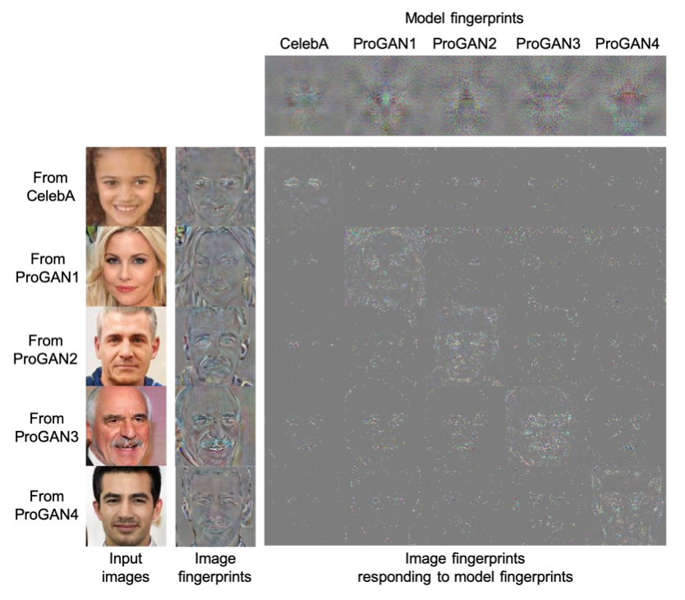
How Would We Learn to Detect Generative Data? (Yu et al.)
Image Fingerprints
Feature Vector encoded from generated image
Model Fingerprints
Representation vector which interacts with each image generated by its respective model
Huh, Minyoung et al. “Fighting Fake News: Image Splice Detection via Learned Self-Consistency.” 10.1007/978-3-030-01252-6_7 - fig. 7

Slide 6
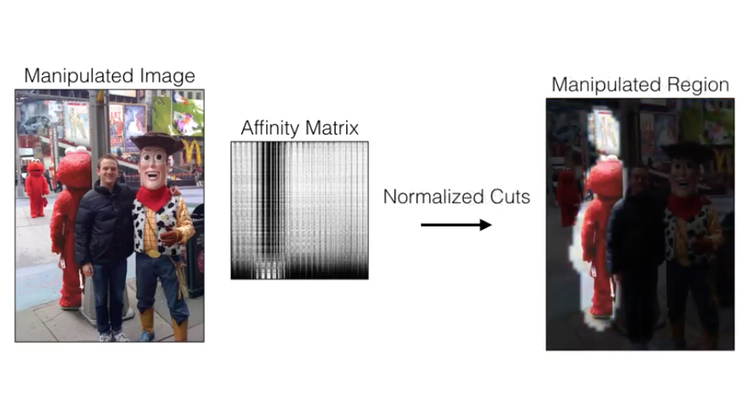
How Would We Learn to Automatically Detect Generative Data? Predicting Metadata Divergence (Huh et al.)
Train model on dataset of unmanipulated, unlabeled images
Model takes two patches from two input images
Predicts EXIF metadata attributes
Results show that attributes related to imaging pipeline are predictable
Trained model performs pair-wise metadata consistency prediction between patches
Generates Affinity Matrix
Visualize inconsistent patches to show probable manipulated region
https://www.youtube.com/watch?v=lmOejdhSio0

Slide 7
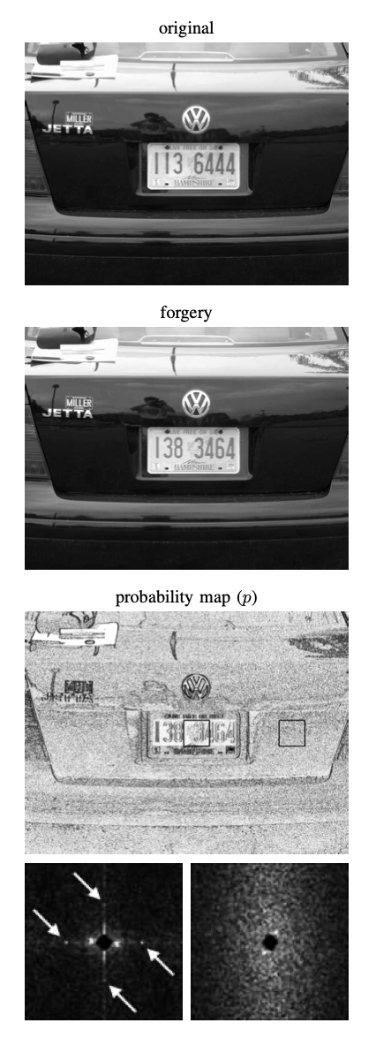
How Would We Learn to Automatically Detect Generative Data? Other Low-level Attributes (Popescu et al.)
Detecting duplicated image regions [7]
Project the image into a reduced dimension representation by performing Principal Component Analysis (PCA) on discretized image blocks
Sort the blocks lexicographically and identify equivalent offsets
Detecting traces of resampling [8]
Correlation signals are introduced into images when they are resampled
Correlations between neighbors can be detected via the Expectation Maximization (EM) algorithm
Color Filter Array (CFA) Interpolation [9]
Tampered images lose information introduced when camera interpolates RGB
The form of correlations and which neighbors are correlated are simultaneously predicted via Expectation Maximization (EM) algorithm
Popescu et al.: Exposing digital forgeries by detecting traces of resampling” 10.1109/TSP.2004.839932 – fig. 9

Slide 8
Can Detectors Transfer Knowledge and Generalize?
Preprocessing
Spectral features emitted by up-sampling components in GANs can be used to train a classifier [11]
Adding blur and random noise to both real and fake images can force a classifier to learn the intrinsic details of each class [12]
Augmentation
Augmenting images by adding blur and formatting to JPEG with randomly selected qualities a classifier can effectively detect fake images from various generative models [13]
Architecture
A bottlenecked autoencoder can express different embeddings for real and fake images [14]

Slide 9
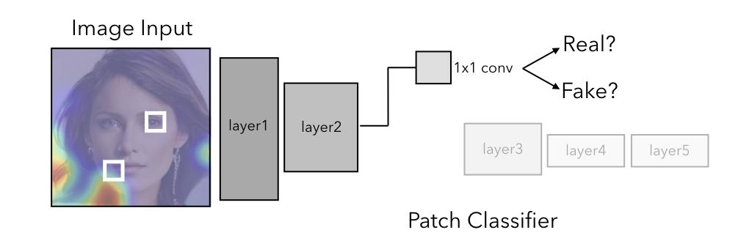
Patch-based Classifier with Limited Receptive Fields
Truncating a model earlier reduces receptive field
Xception
Resnet
Applying a 1x1 conv layer after truncation provides real/fake classification
Patch slides across image and cross entropy is applied to each patch
Final model output is ensemble voting from each patch prediction
Chai et al. “What makes fake images detectable? Understanding properties that generalize” arxiv:2008.10588 - fig 1.

Slide 10
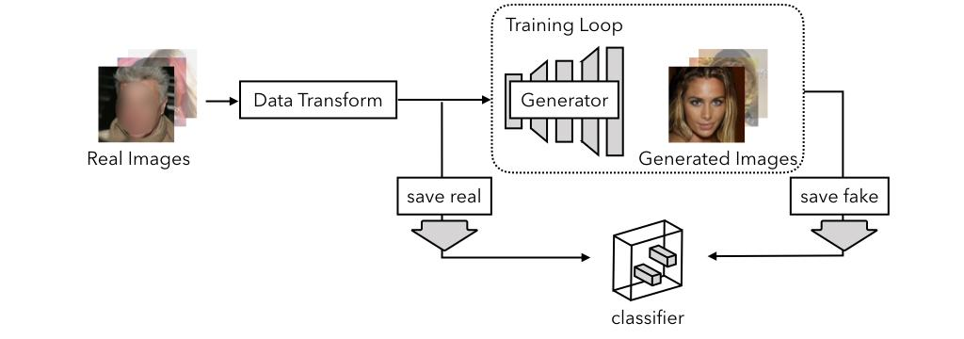
Data Preprocessing to Avoid Learning Differences in Image Formatting
Resize the real images
Save real images as PNG
Resize all images (real and fake)
Datasets Used:
CelebA
CelebA-HQ
Flickr-Faces-HQ
FaceForensics++
Chai et al. “What makes fake images detectable? Understanding properties that generalize” arxiv:2008.10588 - fig 2.

Slide 11
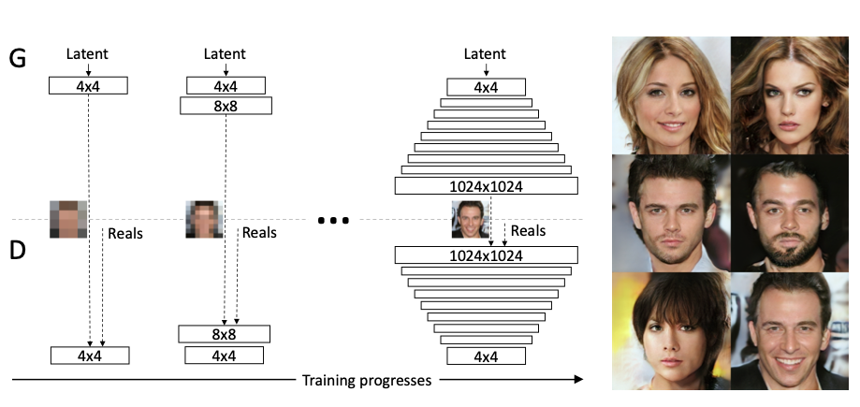
Fully Generative Models - Progressive (P)GAN
Progressively adds layers to generator and discriminator during training
Provides speed-up of training and stability in model
Authors use a model pre-trained on the CelebA-HQ face dataset
Trained custom models
Smaller resolutions
512, 256, and 128px
Different dataset (FFHQ)
Kerras et al. “Progressive Growing of GANs for Improved Quality, Stability, and Variation” arxiv:1710.10196 - fig 1.

Slide 12
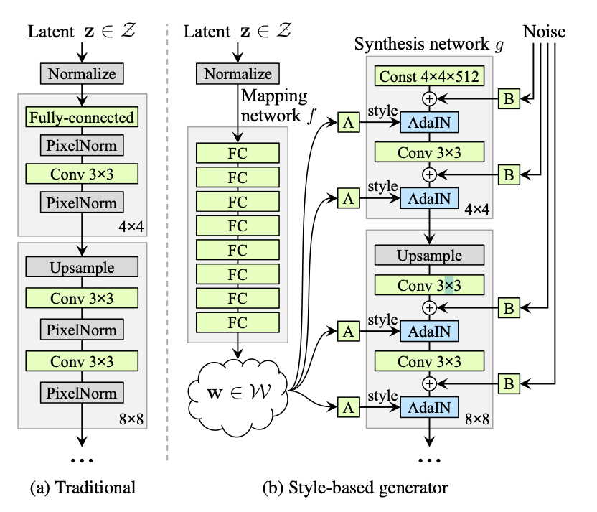
Fully Generative Models - Style (S)GAN
Introduces disentangled latent variables into generator
Hair
Skin tone
Smile
Latent variables allow interpolation between their state
Authors use a model pre-trained on the CelebA-HQ and FFHQ face datasets
StyleGAN2
Improvement over StyleGAN
Authors use model pretrained on the FFHQ face dataset
Kerras et al. “A Style-Based Generator Architecture for Generative Adversarial Networks” 10.1109/CVPR.2019.00453 - fig 1.

Slide 13
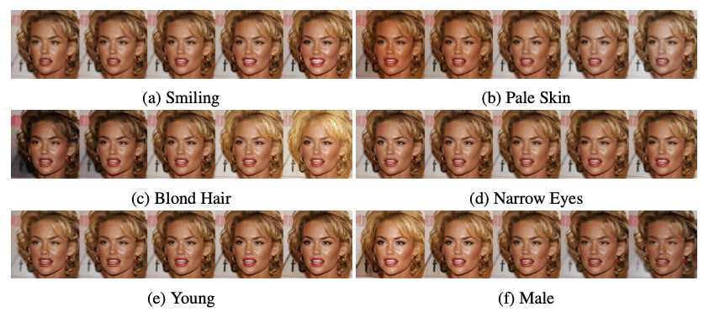
Fully Generative Models - Generative Flow (GLOW)
Optimizes for log likelihood vs. adversarial loss
Also provides latent variable interpolation
Training and synthesis can be parallelized
Authors use model pretrained on the CelebA-HQ face dataset
Kingma et al. “Glow: Generative Flow with Invertible 1x1 Convolutions” arxiv:1807.03039 – fig 6.

Slide 14
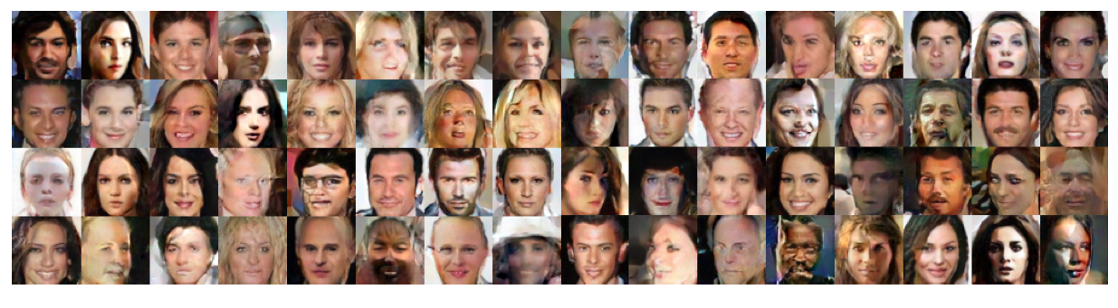
Fully Generative Models - Gaussian Mixture Model (GMM) Generator
Can generate full images
Less resolution than GANS
Does not suffer from ‘mode collapse’
Can model complete probability distribution
Can express statistical structure of image
Authors train this model on CelebA dataset
Richardson et al. “On GANs and GMMs” arxiv:1805.12462 – fig. 9

Slide 15
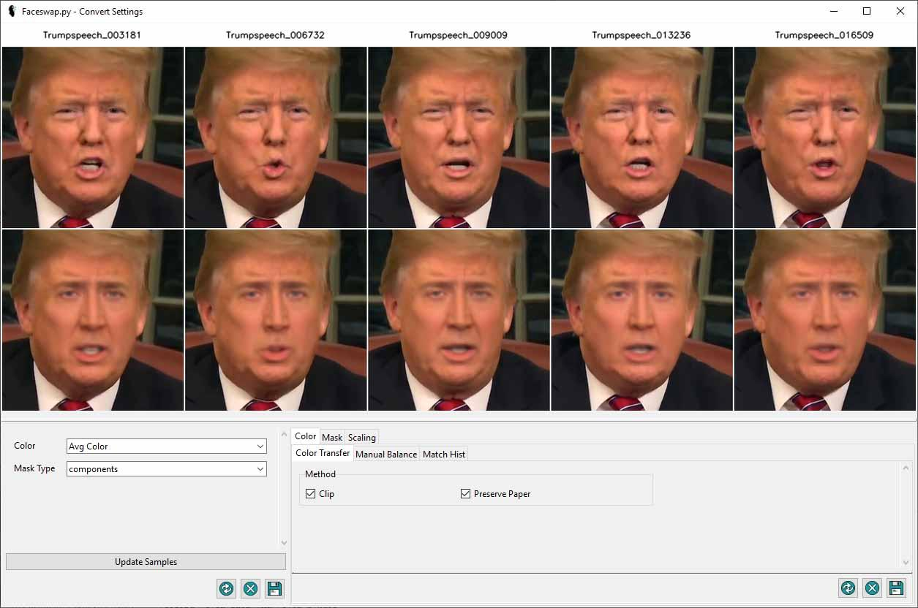
Facial Manipulation Models - FaceSwap
Fits facial landmarks to a predicted 3D model and projects it onto target image
https://forum.faceswap.dev/viewtopic.php?f=7&t=1083

Slide 16
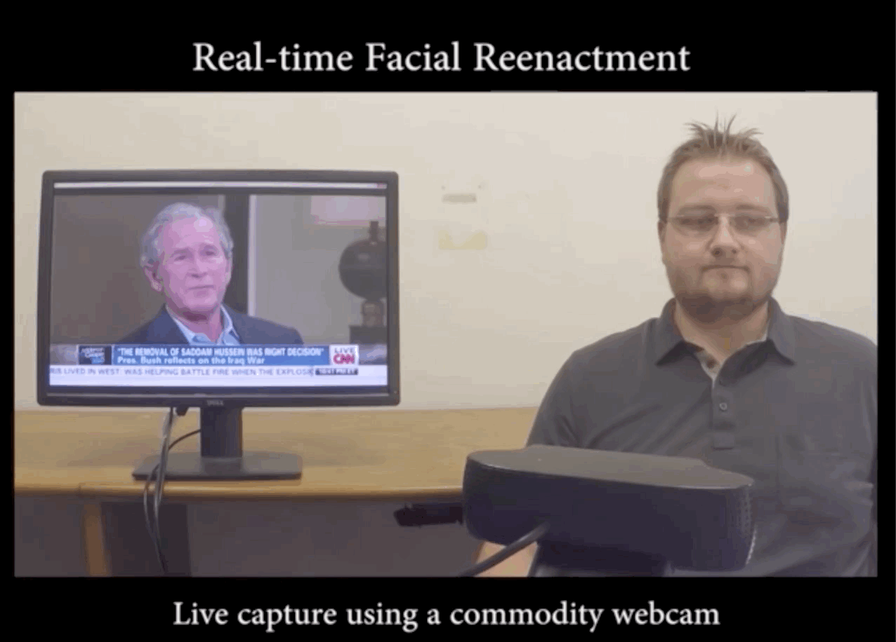
Facial Manipulation Models – Face2Face
Expression transfer between source and target
Detects key expression features and translates them onto video
https://www.youtube.com/watch?v=ohmajJTcpNk

Slide 17
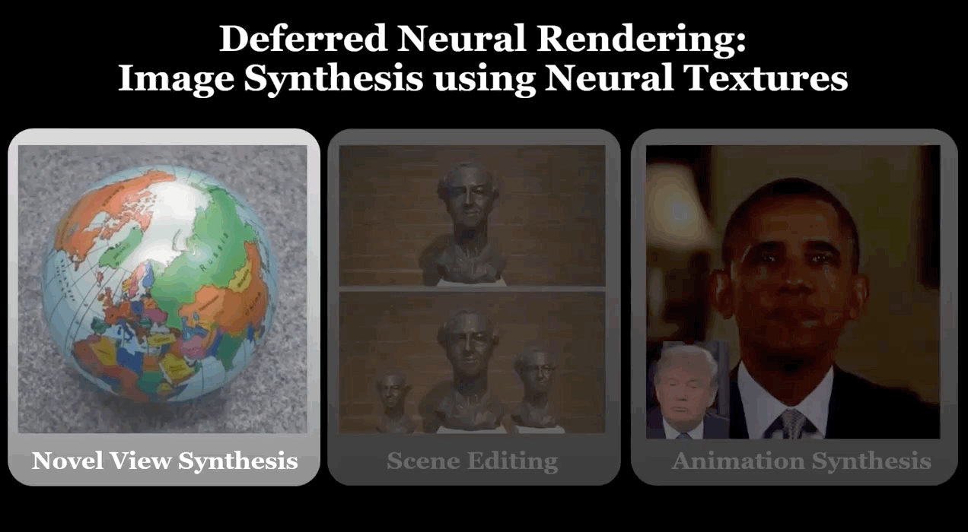
Facial Manipulation Models – Neural Textures
Renders 3D model of object
Rasterizes texture of object using UV-Map
Neural renderer projects texture onto 3D model
https://www.youtube.com/watch?v=z-pVip6WeyY

Slide 18
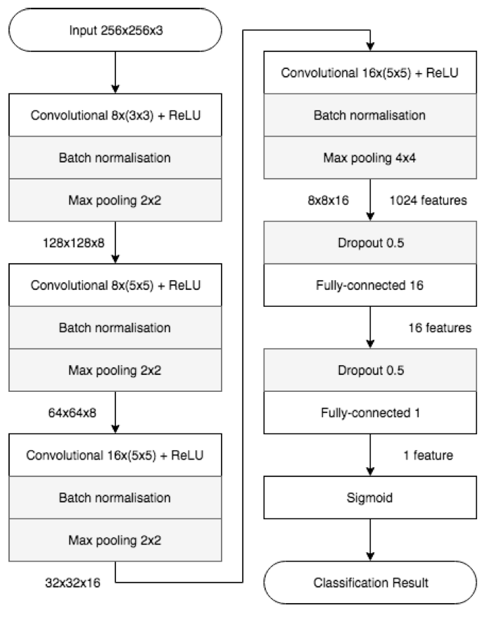
Baseline Models
MesoInception4
Squared Error Loss
Resnet
2 class cross entropy loss
Xception
2 class cross entropy loss
CNN trained on Augmented Data
Afchar et al. “MesoNet: a Compact Facial Video Forgery Detection Network” 10.1109/WIFS.2018.8630761 – fig. 4

Slide 19
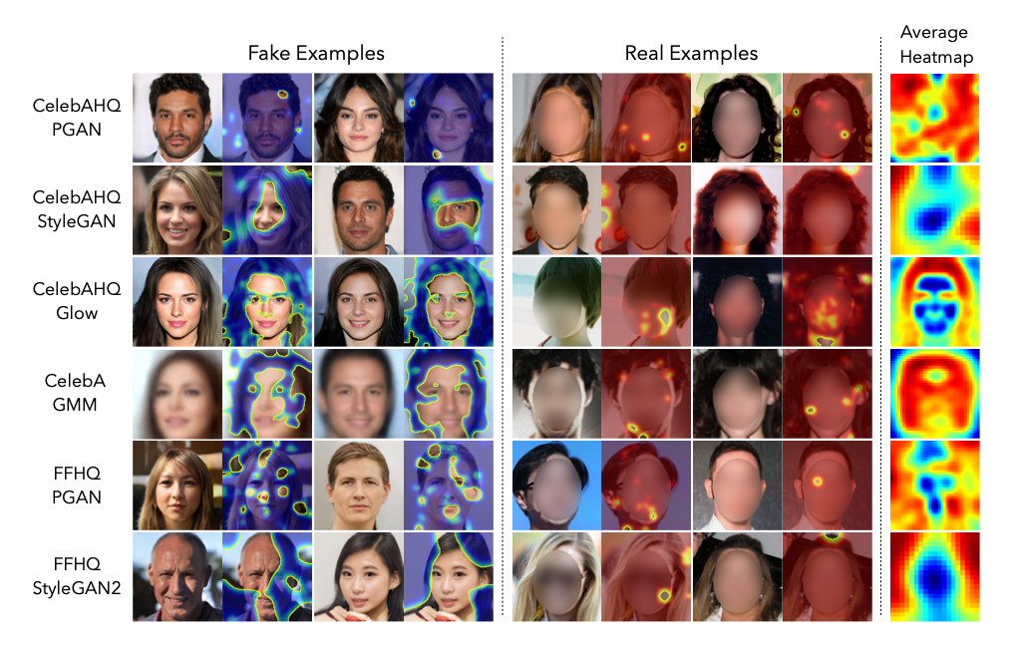
What Properties of Fake Images Transfer Between Models – Heat Map
Predominately hair and background
Chai et al. “What makes fake images detectable? Understanding properties that generalize” arxiv:2008.10588 - fig. 3

Slide 20
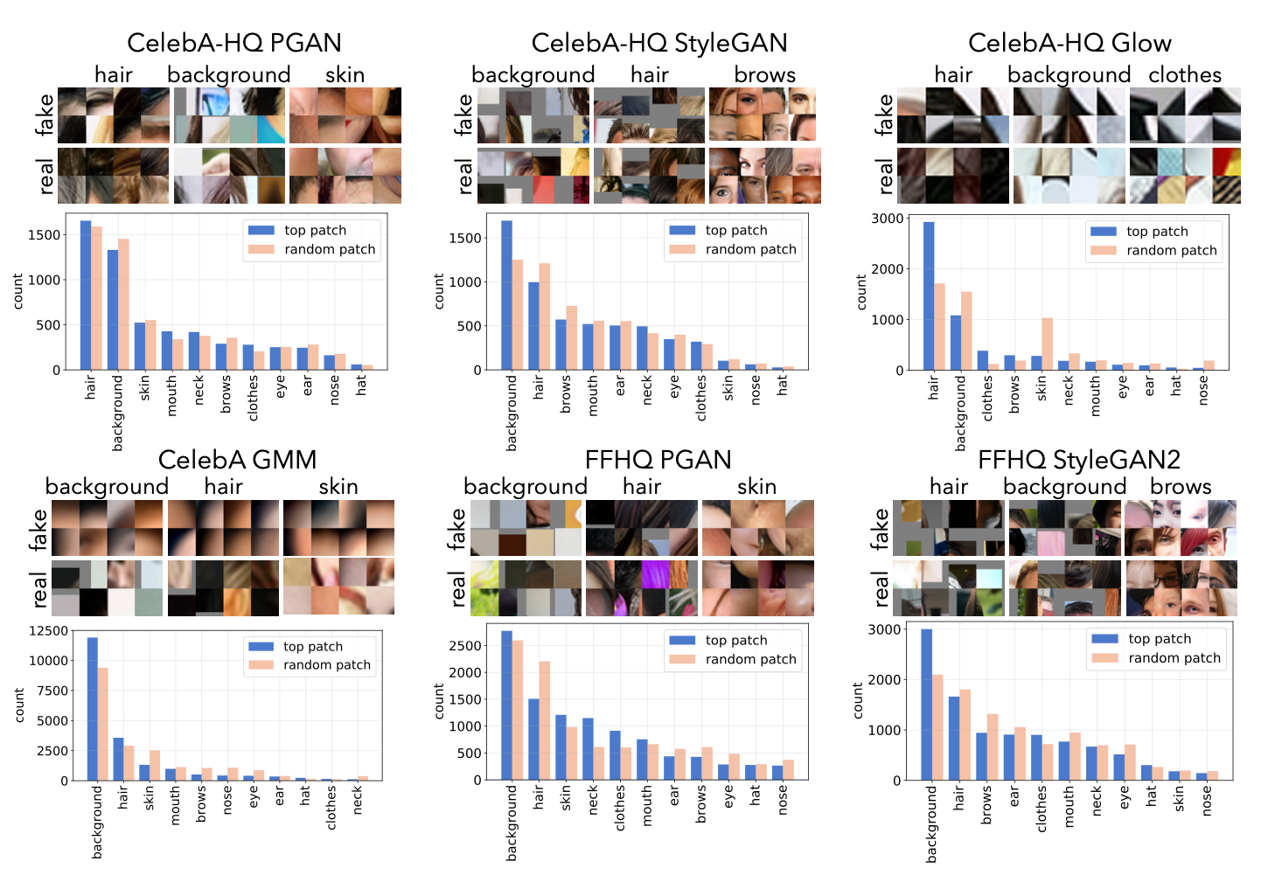
What Properties of Fake Images Transfer Between Models – Segmentation
Predominantly hair and background
Clothes, skin, and brows also indicative
Boundaries are highly represented
Chai et al. “What makes fake images detectable? Understanding properties that generalize” arxiv:2008.10588 - fig. 4

Slide 21
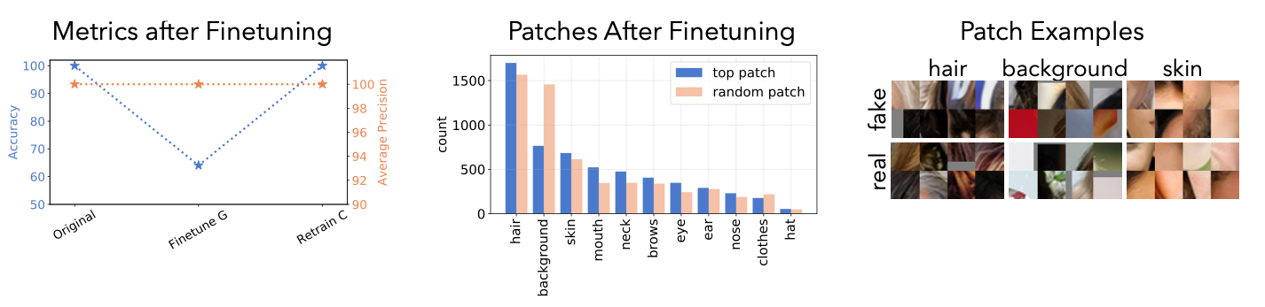
What Properties of Fake Images Transfer Between Models – Finetuning PGAN
Chai et al. “What makes fake images detectable? Understanding properties that generalize” arxiv:2008.10588 - fig. 6

Slide 22
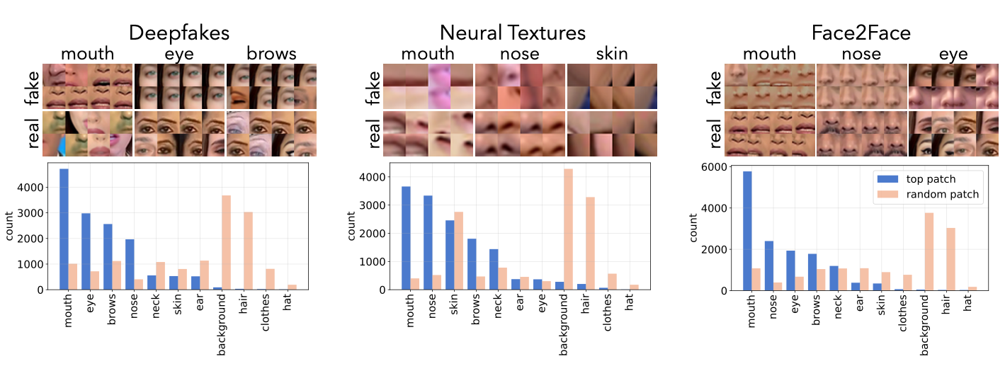
Identifying Properties of Facial Manipulation Models which Transfer
Chai et al. “What makes fake images detectable? Understanding properties that generalize” arxiv:2008.10588 - fig. 7

Slide 23
Complex Textures Contribute Most to Detecting Generative Images
Experiments show that patches local to complex textures are highly represented in accurate classification
Hair
Background
Boundaries
GAN generated images can not overcome uncanny valley effect in loss signal

Slide 24
Shared Difficulty in Generating Complex Textures Hints at Classification Generalization
Models share difficulty generating realistic complex textures
Due to the adversarial nature of GANs, a classifier remains effective only until a generator is trained against it
Visualizing where classifiers identify these difficulties provides a way to anticipate where future generators may seek to improve

Slide 25
Sources
Chai, L. et al. “What makes fake images detectable? Understanding properties that generalize.” ArXiv abs/2008.10588 (2020): n. pag.
Yu, N., Davis, L.S., Fritz, M.: Attributing fake images to gans: Learning and analyzing gan fingerprints. In: Proceedings of the IEEE International Conference on Computer Vision. pp. 7556–7566 (2019)
Ecker, James E. “Deep Learning for Autonomous Systems at NASA Langley Research Center”, presentation to UNM Mechanical Engineering (2020)
Zhang, Han et al. “StackGAN: Text to Photo-Realistic Image Synthesis with Stacked Generative Adversarial Networks.” 2017 IEEE International Conference on Computer Vision (ICCV) (2017): 5908-5916.
Zakharov, E. et al. “Few-Shot Adversarial Learning of Realistic Neural Talking Head Models.” 2019 IEEE/CVF International Conference on Computer Vision (ICCV) (2019): 9458-9467.
Huh, Minyoung et al. “Fighting Fake News: Image Splice Detection via Learned Self-Consistency.” ECCV (2018).
Popescu, A.C., Farid, H.: Exposing digital forgeries by detecting duplicated image regions. Dept. Comput. Sci., Dartmouth College, Tech. Rep. TR2004-515 pp. 1–11 (2004)
Popescu,A.C.,Farid,H.:Exposing digital forgeries by detecting traces of resampling. IEEE Transactions on signal processing 53(2), 758–767 (2005)
Popescu, A.C., Farid, H.: Exposing digital forgeries in color filter array interpolated images. IEEE Transactions on Signal Processing 53(10), 3948–3959 (2005)

Slide 26
Sources continued
Zhou, Peng et al. “Two-Stream Neural Networks for Tampered Face Detection.” 2017 IEEE Conference on Computer Vision and Pattern Recognition Workshops (CVPRW)(2017): 1831-1839.
Zhang, X. et al. “Detecting and Simulating Artifacts in GAN Fake Images.” 2019 IEEE International Workshop on Information Forensics and Security (WIFS) (2019): 1-6.
Xuan, Xinsheng et al. “On the generalization of GAN image forensics.” ArXivabs/1902.11153 (2019): n. pag.
Wang, Shengyu et al. “CNN-Generated Images Are Surprisingly Easy to Spot… for Now.” 2020 IEEE/CVF Conference on Computer Vision and Pattern Recognition (CVPR) (2020): 8692-8701.
Cozzolino, D. et al. “ForensicTransfer: Weakly-supervised Domain Adaptation for Forgery Detection.” ArXiv abs/1812.02510 (2018): n. pag.
Karras, Tero et al. “Progressive Growing of GANs for Improved Quality, Stability, and Variation.” ArXiv abs/1710.10196 (2018): n. pag.
Karras, Tero et al. “A Style-Based Generator Architecture for Generative Adversarial Networks.” 2019 IEEE/CVF Conference on Computer Vision and Pattern Recognition (CVPR) (2019): 4396-4405.
Kingma, Diederik P. and Prafulla Dhariwal. “Glow: Generative Flow with Invertible 1x1 Convolutions.” ArXiv abs/1807.03039 (2018): n. pag.
Richardson, Eitan and Yair Weiss. “On GANs and GMMs.” NeurIPS (2018).
Afchar, Darius et al. “MesoNet: a Compact Facial Video Forgery Detection Network.” 2018 IEEE International Workshop on Information Forensics and Security (WIFS) (2018): 1-7.

Slide 27
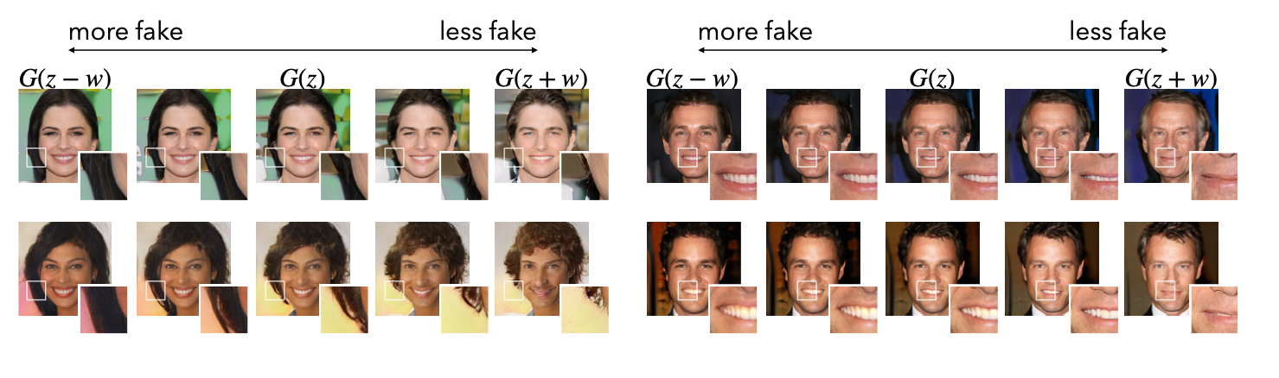
What Properties of Fake Images Transfer Between Models – Shifting Latent Variables
Chai et al. “What makes fake images detectable? Understanding properties that generalize” arxiv:2008.10588 - fig. 5

Slide 28
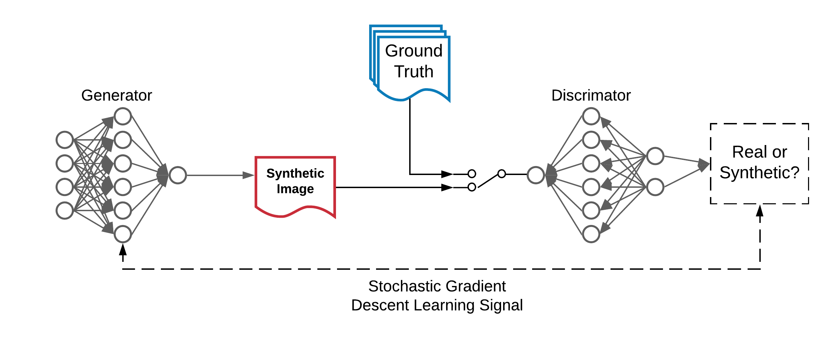
Vanilla GAN
Ecker “Deep Learning for Autonomous Systems at NASA Langley Research Center”
Jensen-Shannon Divergence

Slide 29
Introducing New Loss Function - Wasserstein (W)GAN
Ecker “Deep Learning for Autonomous Systems at NASA Langley Research Center”
Wasserstein Distance instead of Jensen-Shannon Divergence

Slide 30
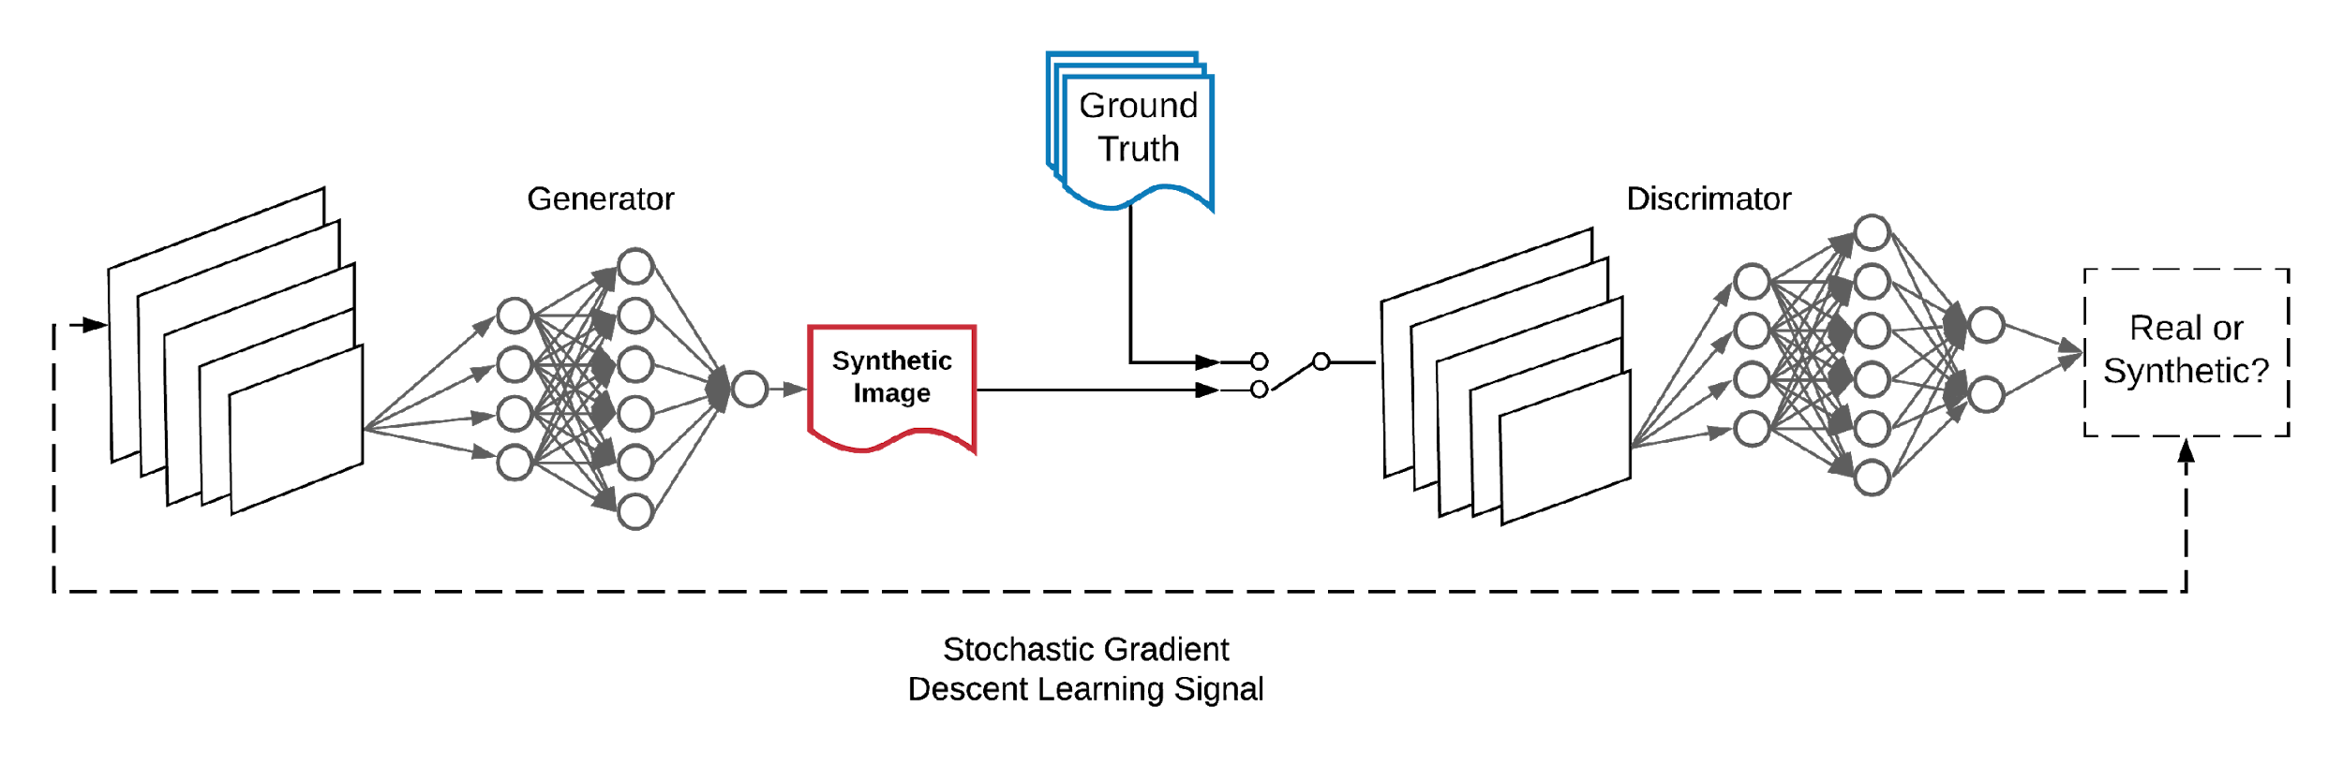
Using a Different Model - Deep Convolutional (DC)GAN
Convolutional Neural Networks (CNN) instead of Multi-Layer Perceptrons (MLP)
Ecker “Deep Learning for Autonomous Systems at NASA Langley Research Center”

Slide 31
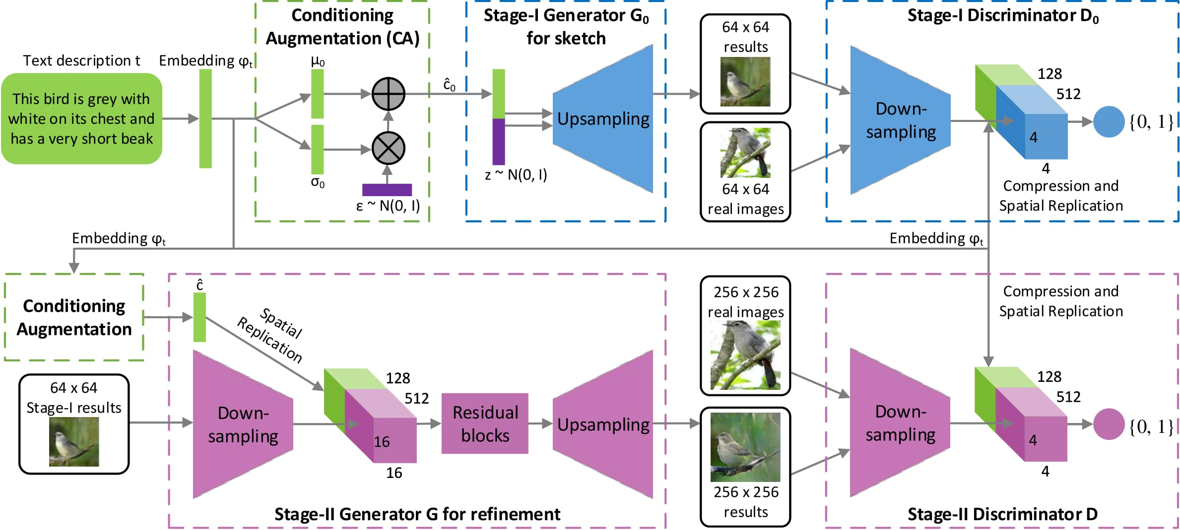
Text to Image - Stack GAN
Zhang et al. “StackGAN: Text to Photo-Realistic Image Synthesis with Stacked Generative Adversarial Networks” 10.1109/ICCV.2017.629 – fig. 2

Slide 32
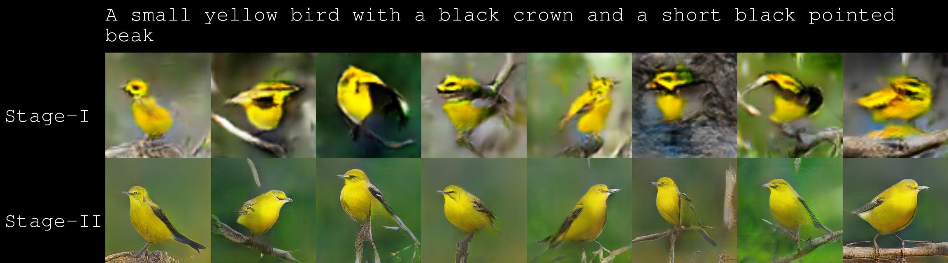
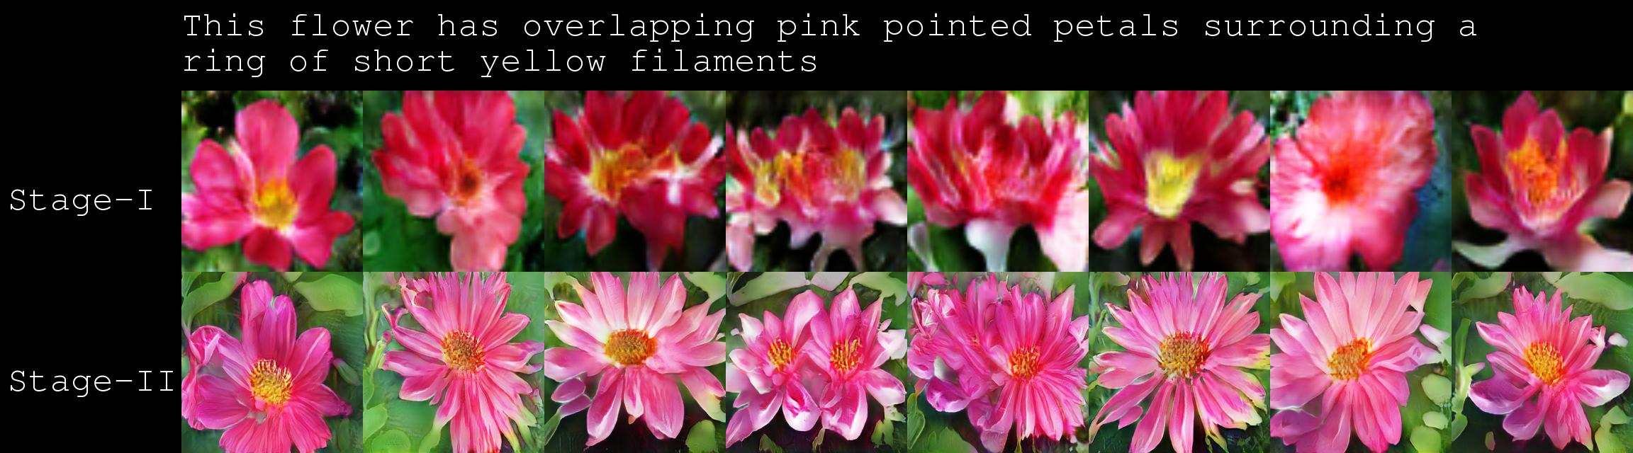
Stack GAN Creates Realistic Images in Two Stages
https://github.com/hanzhanggit/StackGAN

Slide 33
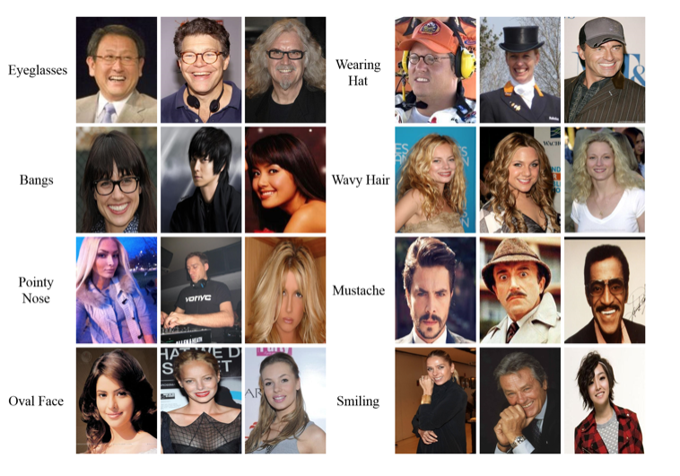
Datasets - CelebA Dataset
202,599 celebrity images
40 attribute annotations each
4 landmark locations
10,177 identities
http://mmlab.ie.cuhk.edu.hk/projects/CelebA.html

Slide 34
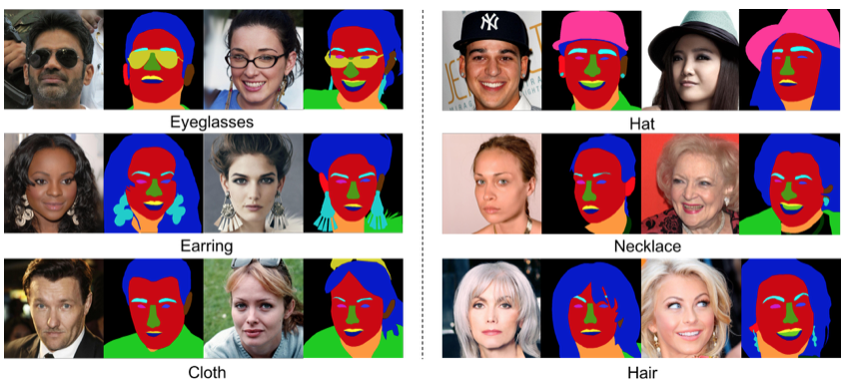
Datasets – CelebA-HQ Dataset
30,000 high resolution celebrity images
Segmentation mask of facial attributes
512px resolution
https://github.com/switchablenorms/CelebAMask-HQ

Slide 35
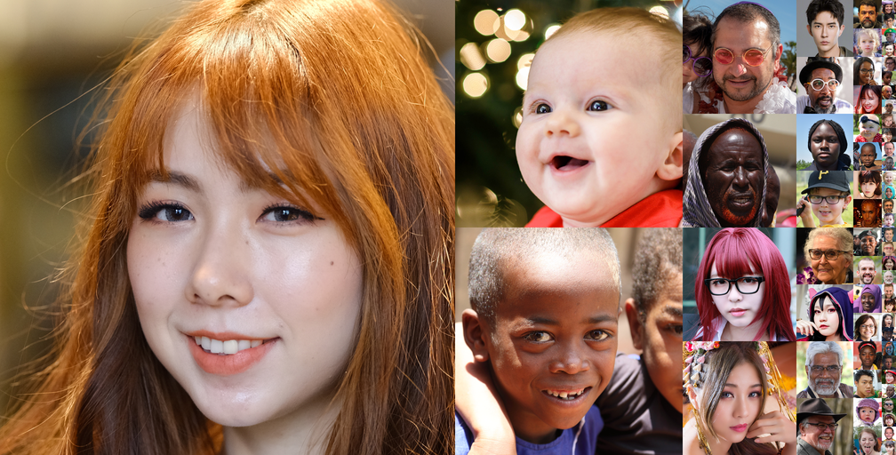
Datasets – Flickr-Faces-HQ (FFHQ) Dataset
70,000 high resolution celebrity images
Good variation in age, ethnicity, image background
https://github.com/NVlabs/ffhq-dataset

Slide 36
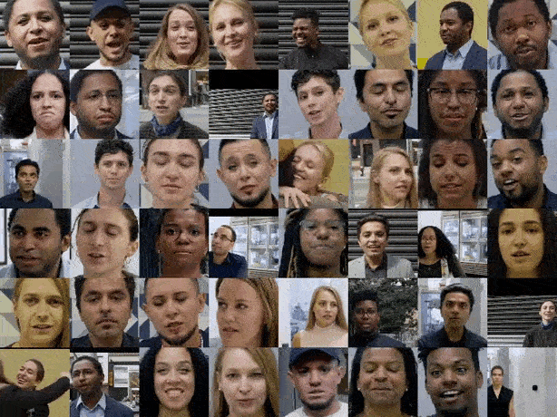
Datasets – FaceForensics++
1000 original video sequences
Each manipulated by
Deepfakes
Face2Face
FaceSwap
NeuralTextures
Sourced from Youtube
1000 pretrained Deepfakes models
https://github.com/ondyari/FaceForensics

